Slide 1


Oracle JavaScript Extension Toolkit Web Components Bring Agility to App Development
Lucas Jellema, CTO of AMIS, Oracle Developer Champion
Oracle OpenWorld 2018, San Francisco, USA
Tuesday, Oct 23, 3:45 p.m. - 4:30 p.m. | Moscone West - Room 3020
Notes:
In this session learn how Oracle JavaScript Extension Toolkit composite components enable a higher level of productivity, agility, and maintainability of rich client web applications. The reusable components can be shared across pages, applications, and teams—and even across the global community. The components can be developed separately from the applications that consume them and can be deployed and updated independently. They are also well-suited to be used as the user interface for a microservice that is mashed up in a larger web application or portal. Learn the why and how of Oracle JavaScript Extension Toolkit composite components, tooling to use for productivity and agility, and a proven approach for microservice UI implementation.

Slide 2
JET Web Component
A reusable building block – encapsulated with a well defined interface
Created using HTML, CSS, JavaScript, JET resources, other JET Web components
Packaged in a Zip file that can be shared with any application and any team
Easily ‘injected’ into a JET application
copy contents of zip-file to specific directory
And easily used in a page
Add tag to View
Load module in ViewModel
JET WC
InputSmiley
My JET Application
Your JET Application
Page 1
Page 2
JET WC
InputSmiley
JET WC
InputSmiley
Page A
Page B
<input-smiley>
<input-smiley>
<input-smiley>
<input-smiley>
<input-smiley>
<input-smiley>
<input-smiley>

Slide 3

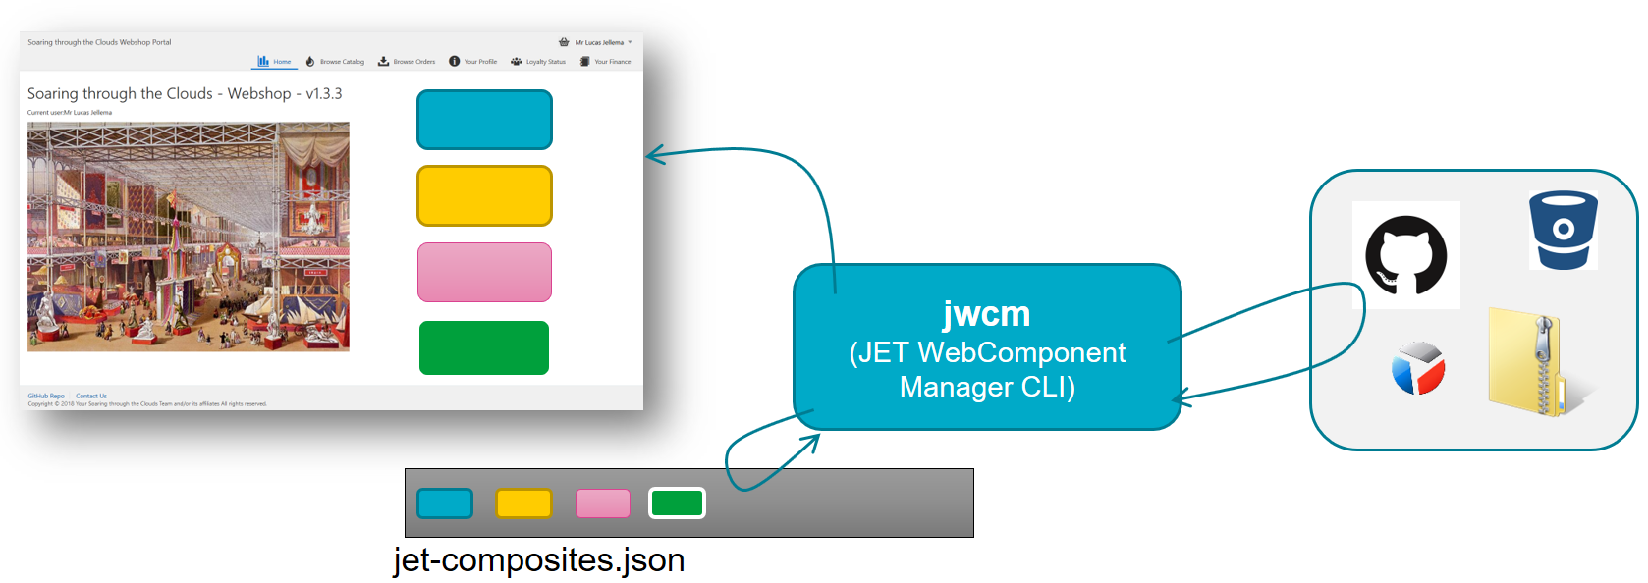
Importance of JET WebComponents
Reuse – across the community
JET WebComponent Exchange
Structured, partitioned development of [large] JET applications
Loosely coupled components collaborating through interfaces and events
Microservices UI Mashup
Each microservice provides its own UI as a JET WebComponents
These UIs are merged at build, deploy or even runtime
JWCM – JET WebComponent Manager
Based on jet-webcomponents.json
Fetch JET WebComponent resources at design time
Reload JET WebComponent resources at design time (even GitHub webhook)
Live fetch JET WebComponent resources from live endpoint (as a close to a WSRP Portlet we can get)

